Slide 1


Slide 2









Salesforce Customer 360
Notes:
Key Messages:
Salesforce Customer 360 is how you put your customers at the center of everything you do.
Customer 360 unites all of your teams - marketing, sales, commerce, service and IT on one integrated CRM platform.
Talk Track
Salesforce Customer 360 is how you can put your customers at the center of everything you do. It is made up of reimagined new digital solutions, like digital sales, digital customer service, digital marketing, and digital commerce - all of which are critical to success in this new era.
It is customer-first by nature. It provides a single view of your customers, empowering your employees to work as one, from anywhere, to deliver seamless, connected customer experiences. This means that your marketing department knows of a customer’s recent service inquiries, so they will not reach out with promotions while a customer is experiencing technical issues. Or your sales team is aware of recent purchases on your commerce platform and tailor their outreach accordingly. Companies have more data than ever... they need to be able to integrate it, analyze it, and understand it - in a trusted and secure way... Which is why we have Analytics with Tableau, and Integration with MuleSoft. Everything is connected to form a single source of truth across all of your touch points.
We even recently updated Customer 360 with new innovations that are needed to survive and navigate this new world safely with equality for all. Customer 360 now includes Sustainability, offering our customers: easy carbon emissions tracking and reporting with Net Zero Cloud, a Climate Action Plan, actionable insights on emissions data, fast and secure supplier collaboration to reduce supply chain emissions - all to help our customers accelerate to Net Zero emissions, to create long-term, sustainable value.
It also includes Health & Safety, allowing you to personalize your industry experiences, deliver care and services from anywhere, innovate with the community, and create safer in-person experiences. With Health & Safety, you can help companies safely return to work, travel, manage contact tracing, and help governments, healthcare providers, nonprofits, and organizations distribute vaccines around the world - to anyone!
And last but not least, the Customer 360 contains Slack, which is your Digital HQ. It connects employees, customers, partners and systems. More on that later.
--------
[Customer example] Engie is a Trusted Enterprise. Engie is a global brand with a passion to impact our planet for the better, offering zero-carbon solutions. They are helping our planet transition to zero-carbon as a Trusted Enterprise. Engie’s Customer 360 serves as a single source of truth, making it easy for teams to collaborate globally and deliver exceptional, custom solutions to meet customers “behind the meter”.
[Customer example] NYC is a great example of a city who moved quickly to help ensure the health and safety of their citizens. With the help of Salesforce, the New York City Department of Information Technology and Telecommunications was able to launch a platform within 3 weeks - helping people in NYC find access to vaccines; helping people to come together and feel good again; helping NYC to come alive again. Salesforce solutions are helping the people of NYC city make their way out of this pandemic, one shot at a time.
Transition: And all of this is built on the world’s #1 platform

Slide 3



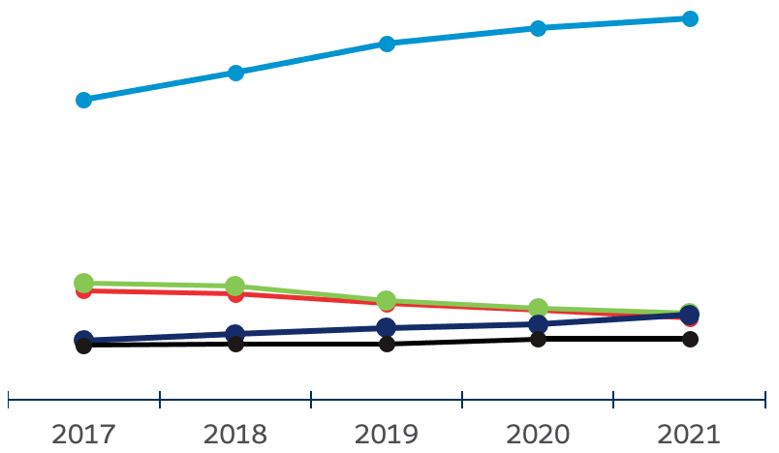


Salesforce. #1 CRM.
Ranked #1 for CRM Applications based on IDC 2021 Revenue Market Share Worldwide.
23.8%
5.4%
5.3%
5.1%
3.8%
2017
2018
2019
2020
2021
Source: IDC, Worldwide Semiannual Software Tracker, April 2022. CRM market includes the following IDC-defined functional markets: Sales Force Productivity and Management, Marketing Campaign Management, Customer Service, Contact Center, Advertising, and Digital Commerce Applications.
Notes:
Key Messages:
Longevity: Salesforce is #1 for 9 consecutive years in CRM according to IDC, with the highest market share at 23.8%. We thank our customers for choosing Salesforce.
Momentum: We are growing at an incredible pace, gaining more than other vendors.
Expansion: not only #1 worldwide, but all in the North America, Western Europe, LATAM and JAPAC regions
Talk Track
Amongst the top 5 vendors shown here, Salesforce is ranked #1 in CRM for the 9th consecutive year.
Salesforce increased its revenue more than any other Customer Relationship Management (CRM) vendor.
In addition to being the #1 CRM provider worldwide, Salesforce is also the #1 market share leader for CRM in North America, Western Europe, LATAM and Asia-Pacific (including Japan).
Behind this top ranking is our customers. It is because our customers have chosen Salesforce, and have found their own success, that we are able to rise to #1. We thank our customers for choosing Salesforce.
Transition:
It’s incredible what we can achieve when we work together. And, once again, we couldn’t do it without our community of Trailblazers.

Slide 4
Salesforce Ecosystem Growth in Philippines

Slide 5
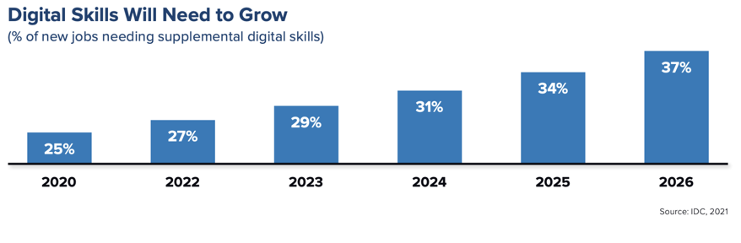
Growth in demand for Digital Skills
Identified by the 2021 IDC Report
Notes:
What is clear is that over the coming 5 years more and more digital skills will be needed to meet the demand, with over a third of these jobs needing digital skills. Having people not only with strong functional knowledge of the industry in which they work, but also a strong digital skillset to support that growth. These will vary by occupation, but knowing how to deal with challenges like IOT, automation tools, AI, chatbots and new collaboration tools like Slack are just some examples of the growing skills sets we need to be ready for.

Slide 6














Salesforce SI partners / Customers in Philippines

Slide 7
Trailhead Student Program

Slide 8


Slide 9




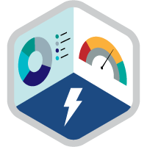
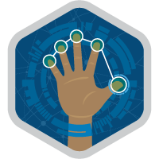
Earn Globally-Recognized Salesforce Credentials
Validate your skills and grow your resume
Super Sets
Skill-based credentials
Apply your Salesforce skills to hands-on, real-world business problems.
Showcase your expertise in a specific domain with Super Sets.
Certifications
Role-based credentials
Prove your hands-on experience with Salesforce to get a competitive edge that leads to new opportunities.
Notes:
Talk track: And on Trailhead, you can earn resume-worthy Salesforce Credentials to validate your skills and prove your expertise.

Slide 10

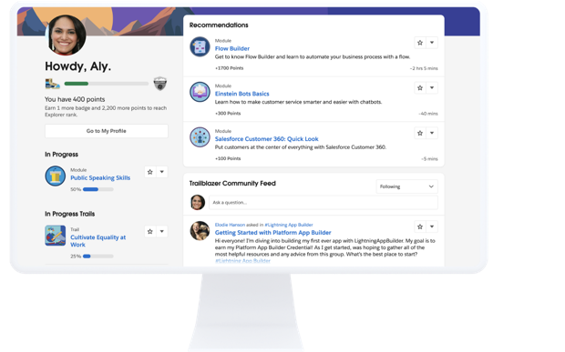


Prep for your career with Trailhead!
Aaron McGriff
Salesforce Consultant
Skill up for the future
Learn In-Demand Skills
Learn the skills companies need to drive success from anywhere either on-demand or from Trailhead Academy experts.
Earn Resume-Worthy Credentials
Prove your expertise with skill-based badges and role-based credentials that lead to top jobs in the Salesforce Ecosystem.
Connect to a Global Community
Connect with the Trailblazer Community, a network of millions of people who help each other along the journey of learning and succeeding with Salesforce.
3.9M+ learners have skilled up on Trailhead
Source: Trailhead
Notes:
Enter, Trailhead. Trailhead is our free online learning platform and the front door to the Salesforce Ecosystem. It empowers anyone to skill up for the future and businesses to reskill their workforce.
With Trailhead, anyone can learn in-demand skills, including tech, business, Salesforce and soft skills. And there are many ways to learn - whether on-demand from your laptop, from your phone with Trailhead GO, or directly from experts in virtual classrooms with Trailhead Academy.
And as Trailblazers are learning, they’re also earning resume-worthy credentials certifying they have the knowledge and skills that companies need today.
TB Community –
Resources
Trailhead B2B First Call Deck

Slide 11







Trailhead Ranks
Motivate learners to aspire higher
Badges 100
Points 50,000
Badges 50
Points 35,000
Badges 25
Points 18,000
Badges 10
Points 9,000
Badges 5
Points 3,000
Badges 1
Points 200
Badges 0
Points 0

Slide 12
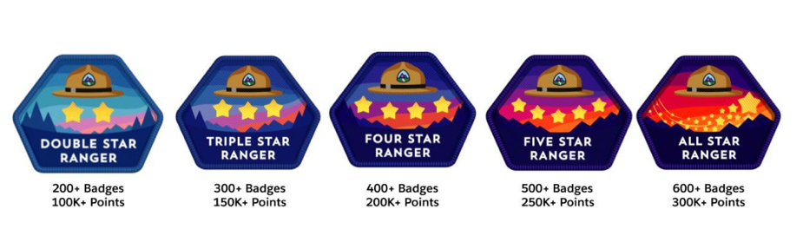
Ranger Rank in Trailhead

Slide 13








Preparing People for Multiple In-Demand Careers
Non-technical, technical, or techno-functional, there’s a path for you!
Salesforce Consultant
Salesforce Architect
Salesforce Developer
Salesforce Administrator
Salesforce Designer
Marketing Careers
Service Careers
Sales Careers
Business Analyst
Notes:
Note to chat moderator: Drop this link in the chat trailhead.salesforce.com/career-path
Talk Track: Many people assume that because Salesforce is a technology company that these jobs will be technical. That isn’t the case! Salesforce skills aren’t all about developing or coding. The 9.3 million jobs from earlier spans across roles technical AND non-technical or a mix of technical and nontechnical. There are 9 careers listed on the screen and the link to the Trailhead career page will give you more information, but I want to highlight Administrator, Developer, Business Analyst, and Consultant roles as these are common entry-level Salesforce roles employers hire for.
Salaries range depending on your location, but we’ve heard countless stories of job seekers doubling or tripling their earnings by taking a few months to train up on Salesforce, getting certified, to landing their first role.
What types of employers have these career paths?
Customers like Adidas and Lyft from the earlier example need help using the Salesforce platform to connect with their customers. Common positions at customers (but not limited to these) are in customer service, marketing, or working as an Admin to give customer service agents and marketers the right permissions and reports they need.
Partners have a different mission. They aren’t technically using Salesforce to connect with customers. They work with Adidas and Lyft to help them learn how to use Salesforce software. Common positions here are Developers and Consultants.
Depending on the position, different certifications and skills are used. Regardless of the position though, having these skills on your resume will give you a competitive edge.
Transition: We have one more knowledge check.

Slide 14
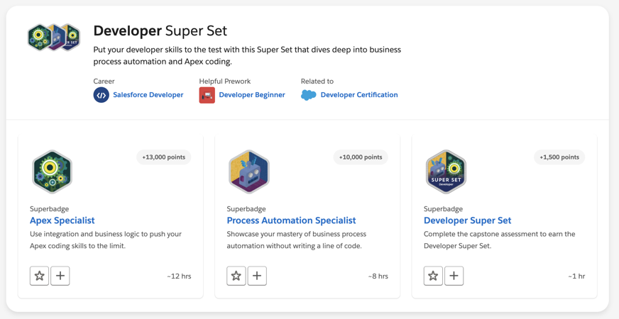
Developer Super set

Slide 15
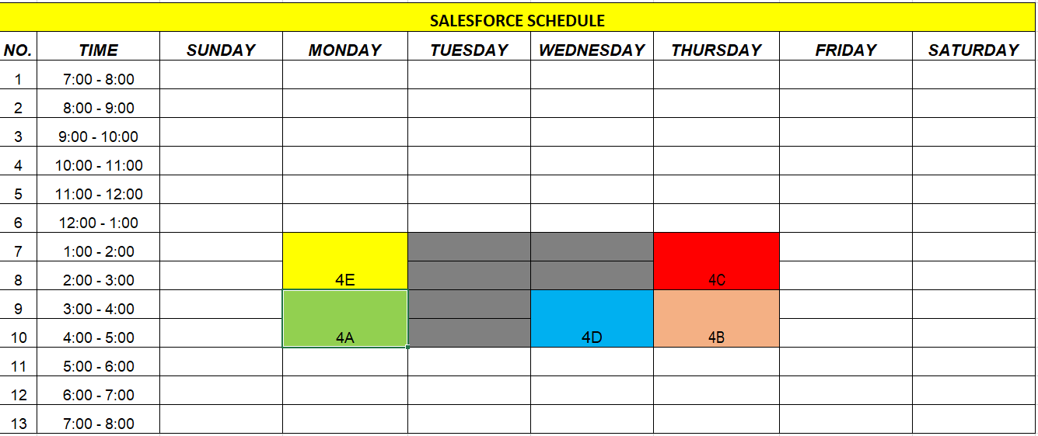

Slide 16
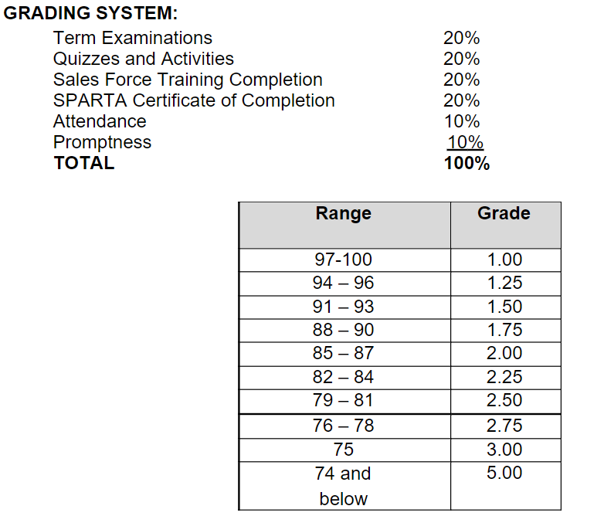

Slide 17


